Slide 1











My AI
Project
Presented By Julia Tfaily

Slide 2

About Me
Hi, I’m Julia. I love school, and animals. I love math, and biology, along with coding. I also play the Piano, and my mom is a guitarist.
I’m in the 7th grade, and I live in Lebanon. What about you? Which school do you go to and where?

Slide 3
Reasons for AI
01
02
Career Opportunities – Learning AI opens doors to jobs in tech, healthcare, finance, and more.
Innovation and Automation – It allows you to develop smarter systems that can automate tasks and improve efficiency.

Slide 4
Expectations
My expectation is to expand my AI knowledge, become a programmer, and contribute to making a positive impact. I’m excited to learn more advanced skills and code.
I also believe that, in the future, I’ll be able to make a real impact by creating my own apps and websites that can help others.

Slide 5

Project Overview
It’s called “Text Emotion Recognition App”. I think this app would be useful for expressing emotions and feelings. It could analyze what you type or say and even suggest solutions or advice.
For example, if you say “I’m really
frustration and suggest relaxation tips
stressed,” the app might detect
or calming music.

Slide 6

Why did I Choose this Project?
Reason 1
Reason 2
Helps Understand Emotions – It can analyze feelings even when they are hard to express.
Provides Support – It may offer solutions or advice to improve moods and well-being.

Slide 7
Is it Beneficial?
It can be beneficial because it may help people understand and express their emotions better. It can also provide and support suggestions, or solutions to improve moods and well-being.
For example, what if you gave the word: ugly. Ugly may indicate several emotions like disgust. What do you think?

Slide 8
Conclusion
In conclusion, text emotion recognition can be a useful tool for detecting emotions, even when they are not directly expressed. By analyzing written messages, it can help in areas like customer service, mental health support, and communication, making interactions more understanding and effective.
For example, if your friend is acting strangely over text but says they’re fine, you could use emotion recognition software. Typing “I’m not that fine” might reveal emotions like sadness or anger, helping you understand how they really feel.

Slide 9


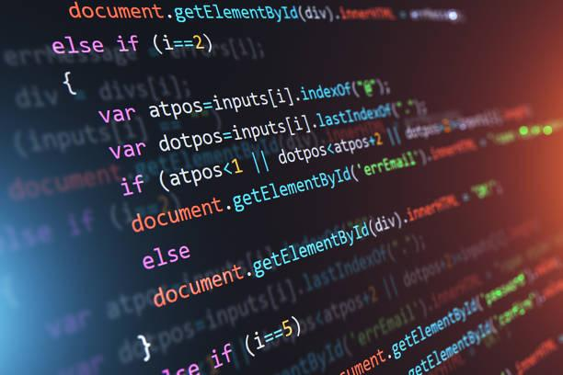
Pictures

Slide 10
Thank
You

